Slide 1

COMPUTER NETWORKS
07 JULY 2026

Slide 2
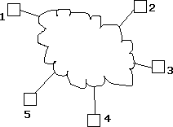
Introduction to networks
A Network: A group of devices that can communicate with each other over links.
Each device is called a host. Each host has a unique address.

Slide 3
Network is a connection between two or more devices.
Which is connected by a communication links.
A node can be a computer, a printer, or any other device that is capable of sending and receiving information with other nodes.

Slide 4
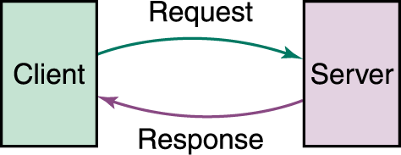

Slide 5
Data Communication is the movement of computer information from one point to another by means of electrical or optical transmission systems
Telecommunications is a broader term and includes the transmission of voice and video (images and graphics) as well as data and usually implies longer distances

Slide 6
What do we use computer networks for?
Notes:
Connect devices like phones & computers to share information
We chat,
Work together from various places, access entertainment
Work and shopping

Slide 7
Social issues
Privacy Concerns
Data collection and surveillance in networks
Impact on personal information security
Digital Divide
Unequal access to technology and internet
lack of internet or devices limits education and economic opportunities.
Cybersecurity Threats
Hacking, identity theft, and data breaches
Need for robust security protocols
Ethical Dilemmas
Use of AI and automation in communication
balance innovation with its societal impact, ensuring technology benefits rather than harms

Slide 8
Types of networks
  LAN - Local Area Network
  MAN - Metropolitan Area Network
  WAN – Wide Area Network

Slide 9
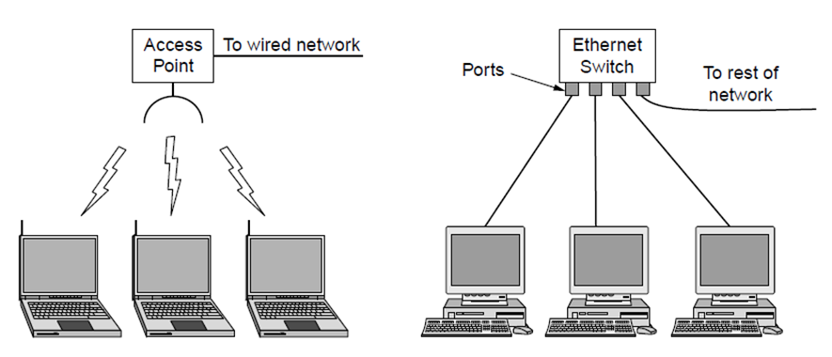
Local area networks
Connect devices in a home or office building
Called enterprise network in a company

Slide 10
Local area network
Benefits
  High-Speed Connectivity: Fast data transfer within a localized area (e.g., building/campus).
  Resource Sharing: Enables file, printer, and device sharing among users.
  Cost-Effective: Lower infrastructure costs compared to wide-area networks.
  Improved Security: Easier to manage and secure within a confined network.
  Reliability: Consistent performance with fewer external interferences.

Slide 11
Drawbacks
  Limited Range: Restricted to a small geographic area (e.g., up to a few kilometers).
  Reconfiguration Challenges: Difficult to add or remove devices without disrupting the network.
  High Initial Cost: Significant investment in hardware and setup.
  Single Point of Failure: Central hub or server failure can disable the entire network.
  Maintenance Overhead: Requires regular updates and technical support.

Slide 12
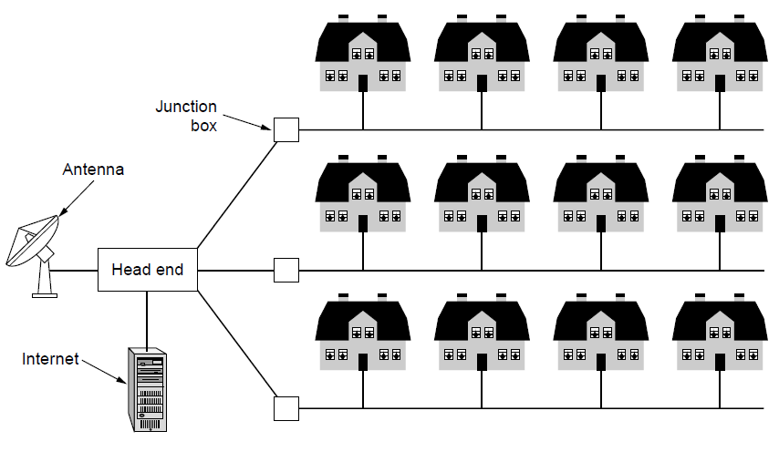
Metropolitan area networks
Connect devices over a metropolitan area (city, multiple cities, and towns)
MAN is made up of interconnected LANs
because MANs are smaller, they are efficient than WANs
Since data don’t travel over large distances
Notes:
University campuses
Cable television
Hospital systems

Slide 13
Benefits
High Bandwidth: Supports high-speed data transfer across a metropolitan area, ideal for cable TV and internet services.
Supports Large Number of Clients: Handles numerous users within a city, such as businesses and residents.
Reduce the Errors: Enhances data reliability over urban distances, minimizing transmission errors.

Slide 14
Drawbacks
Large Space Requirements: Needs extensive cabling or infrastructure (e.g., telephone lines), demanding significant urban space.
Slower Data Access: Potential latency due to city-wide coverage and traffic, despite high bandwidth.
High Cost: Expensive to deploy and maintain, including urban infrastructure and service agreements.

Slide 15
Wide area network
Interconnects smaller networks, such as LANs, enabling communication between devices
This allows connectivity between different
  Offices, cities, or even countries to connect & share information as if they were on the same LAN.
  It acts as a network of networks providing connectivity over extended distances.

Slide 16
Types of WAN technologies
Leased lines
Multiprotocol label switching
Virtual private network
Software-defined WAN

Slide 17
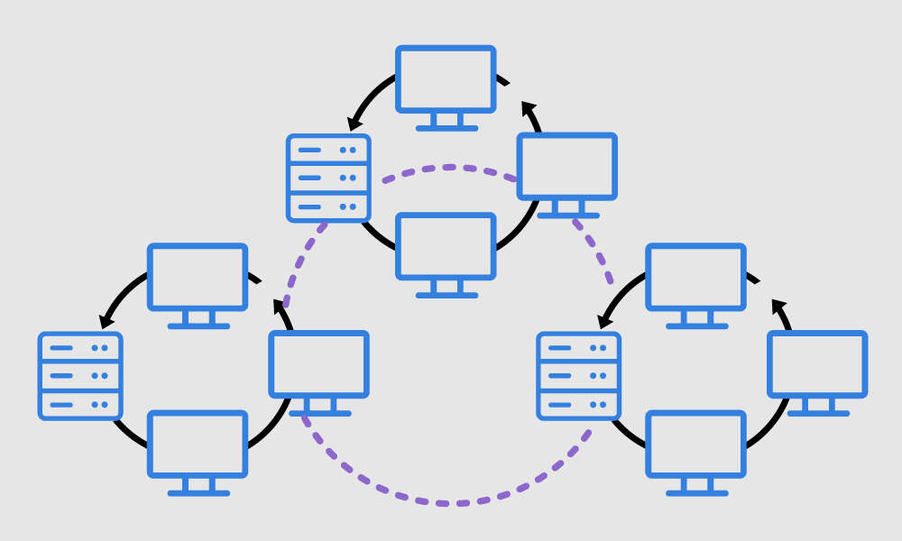

Slide 18
benefits
Workplace can be anywhere (flexibility)
global connectivity
Centralized IT infrastructure
Resource & software sharing
Enhanced communication
Disaster recovery & backup

Slide 19
drawbacks
High setup & maintenance costs
Security risks
Performance issues like (latency & heavy reliance on third-party service providers)
High complexity & troubleshooting difficulty

Slide 20
Another way to categorize networks is in terms of access:
Intranet
  A network (often a LAN) that uses the Internet technologies to share information within an organization
  Open only to those inside the organization
  e.g., employees accessing budgets, calendars, and payroll information available through the organization’s intranet
Extranet
  A network that uses Internet technologies to share information between organizations
  Open only to those invited users outside the organization
  Accessible through the Internet
  e.g., suppliers and customers accessing the inventory information of a company over an extranet

Slide 21
Components
Core Concepts
  Client-Server: Client sends a request, server provides a response (e.g., web browsing).
  Data Communication: Exchange of data over a link or channel using signals.
  Transmission: Flow of data through a path or route managed by control and management.
Network Devices
  Router: Directs traffic between networks, choosing optimal routes.
  Hub: Connects multiple nodes in a network, broadcasting data.
  Switch: Efficiently forwards data to specific devices.
  Gateway: Links different networks (e.g., LAN to WAN), acting as a protocol converter.
  Node: Any device (e.g., computer) in the network.

Slide 22
Infrastructure & Performance
  Bandwidth: Capacity of the channel to carry data, affecting transmission speed.
  Traffic: Volume of data flow, managed by equipment like routers.
  Connection: Established via infrastructure (cables, fiber) and access points.
  System: Integrated components (e.g., hub, switch) ensuring signal integrity.

Slide 23
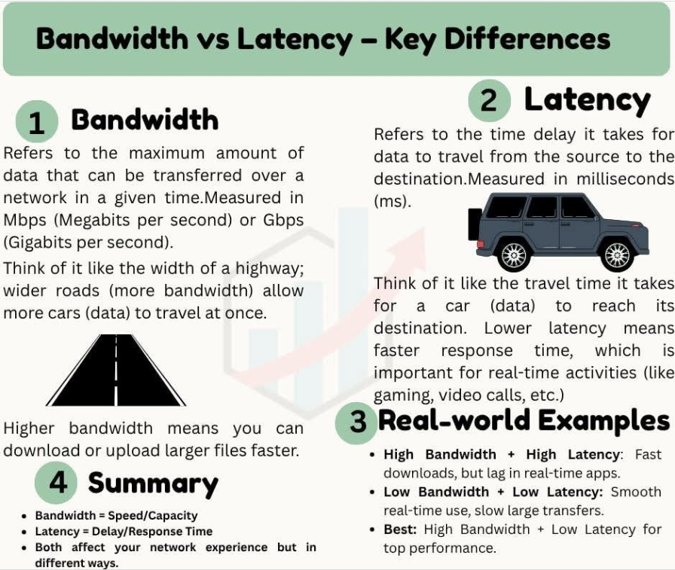

Slide 24
SECTION 1
TYPES OF NETWORKS
TOPOLOGIES

Slide 25
TOPOLOGIES

Slide 26
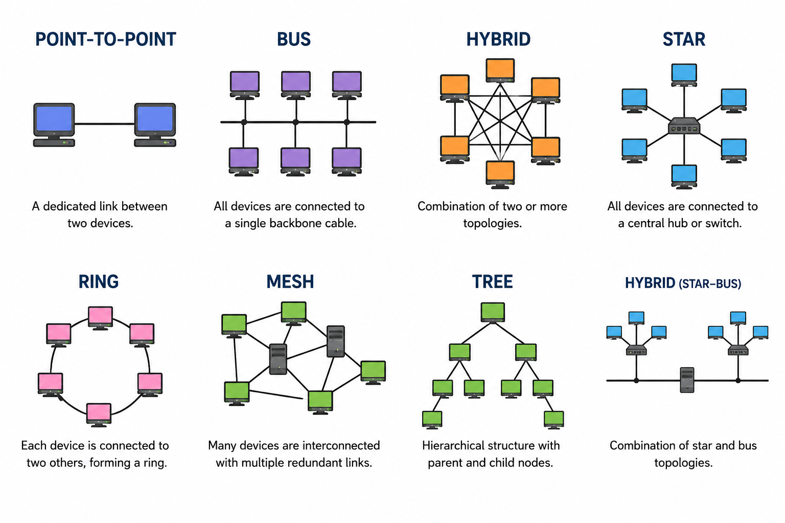
NETWORK TOPOLOGY

Slide 27
NETWORK TOPOLOGY
The arrangement of a network that comprises nodes and connecting lines having a sender and a receiver.
As seen in slide 1
Bus topology, star, ring, and so forth

Slide 28
Bus topology
Is a network type in which every computer and network device is connected to a single cable. When it has exactly two endpoints, then it is called Linear Bus Topology.
Features of bus topology
  It transmits data only in one direction
  Every device is connected to a single cable
  Advantages of bus topology
  It is cost-effective
  Cable require is least compared to other network topologies
  it is easy to understand
  Easy to expand by joining two cables together

Slide 29
Continuation…
Disadvantages of the bus topology
Cables fail, then the whole network fails
If network traffic is heavy or there are more nodes, the performance of the network decreases
Cable has a limited length
It is slower than the ring topology

Slide 30
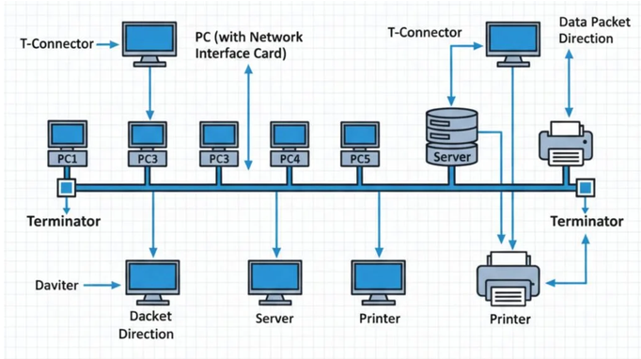

Slide 31
Star Topology
All the computers are connected to a single hub through a cable. This hub is the central node and all other nodes are connected to the central node.
Features of star topology
Every node has its own dedicated connection to the hub
Hub acts as a repeater for data flow
Can be used with twisted pair, optical fibre or coaxial cable

Slide 32
Continuation…
Benefits
Fast performance with few nodes and low network traffic
Only node affected will failed; the rest of the nodes can work smoothly
Hub can be upgraded easily
Easy to troubleshoot
Easy to set up and modify

Slide 33
Continuation…
Drawbacks
Cost of installation is high
Expensive to use
If the hub fails then the whole network is stopped because all the nodes depend on the hub
Performance is based on the hub, meaning depends on capacity of the hub

Slide 34
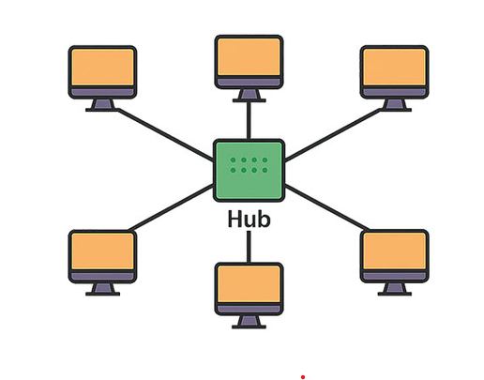

Slide 35
Ring Topology
It forms a ring as each computer is connected to another computer, with the last one connected to the first. Exactly two neighbors for each device.
Features
The transmission is unidirectional, but it can be made bidirectional (Dual Ring) Topology.
In a dual ring topology, two ring networks are formed, and data flow is in opposite directions in them.
Also, if one ring fails, the second ring can act as a backup to keep the network up.
Data is transferred in a sequential manner, one bit at a time. Data transmitted has to pass through each node in the network until it reaches the destination node.

Slide 36
Continuation…
Benefits | drawbacks
Transmitting network is not affected by high traffic or by adding more nodes, as only the nodes having tokens can transmit data. | Troubleshooting is difficult in ring topology
Cheap to install and expand | Adding or deleting the computers disturbs the network activity. Failure of one computer disturbs the whole network

Slide 37
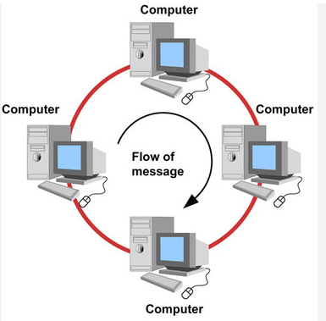
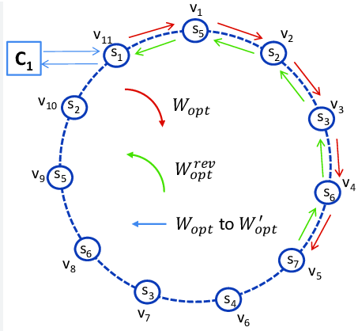

Slide 38
Mesh topology
It is a point-to-point connection to other nodes or devices. All the network nodes are connected to each other. Mesh has n(n-1)/2 physical channels to link n devices.
There are two techniques to transmit data over the mesh topology, they are:
  Routing, the nodes have a routing logic, as per the network requirements. routing logic direct the data to reach the destination using the shortest distance.
  We can even have routing logic to reconfigure the failed nodes.
  Flooding: the same data is transmitted to all the network nodes, hence no routing logic is required. The network is robust, and it’s very unlikely to lose the data, but it leads to an unwanted load over the network.
Notes:
Robust – strong, healthy, not likely to break or fail

Slide 39
Continuation…
Partial mesh
In this topology some of the systems are connected in the same fashion as mesh topology but some devices are only connected to two or three devices.
Each and every node or device is connected to each other
Features of mesh topology
Fully connected
Robust
Not flexible

Slide 40
Benefits | Drawbacks
Each connection can carry its own data load | Installation and configuration is difficult
It is robust | Cabling cost is more
Fault is diagnosed easily | Bulk wiring is required
Provides security and privacy

Slide 41
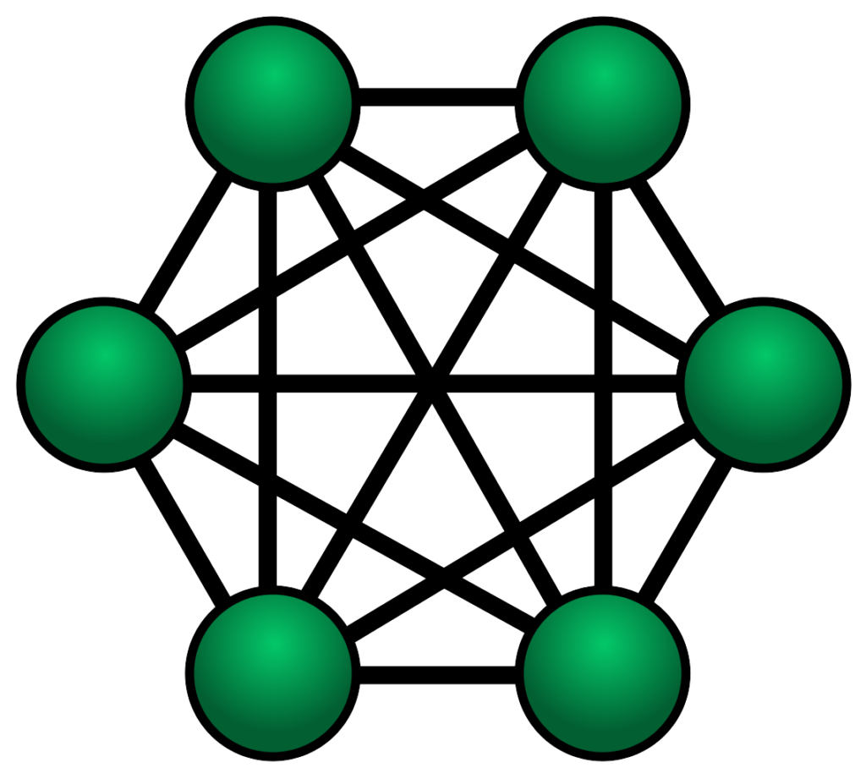

Slide 42
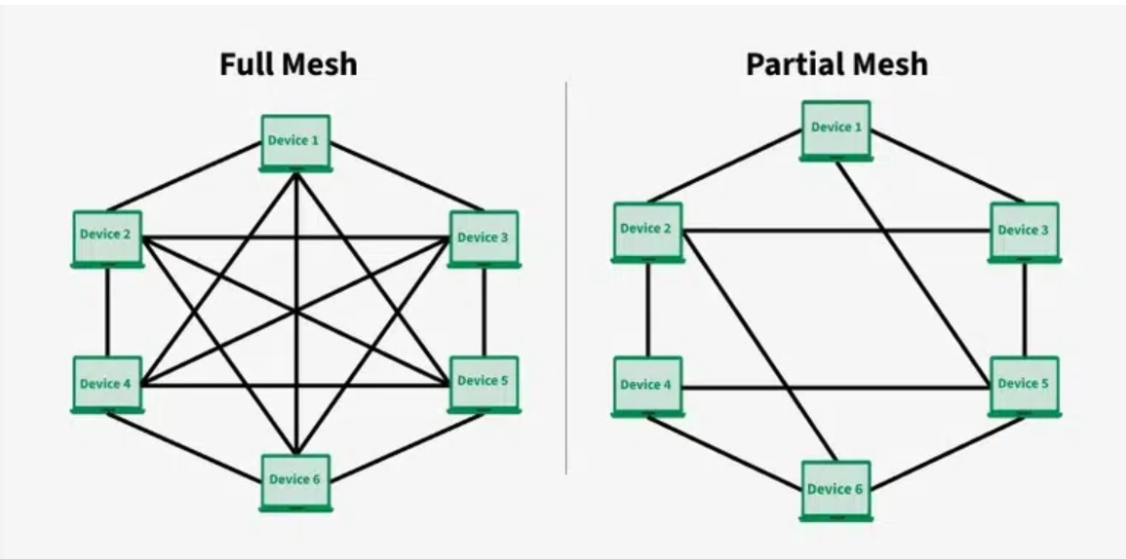

Slide 43
Tree Topology
It has a root node and all other nodes are connected to it forming a hierarchy. It is also called hierarchical topology. It should at least have three levels to the hierarchy.
Features of Tree Topology
Ideal if workstations are located in groups
Used in wide area network

Slide 44
Benefits Vs Drawbacks
Extension of bus and star topologies
Expansion of nodes is possible and easy
Easily managed and maintained
Error detection is easily done
Heavily cabled
Costly
If more nodes are added, maintenance is difficult
central hub fails, network fails

Slide 45
Hybrid Topology
Hybrid topology combines two or more topologies
For example, if in an office in one department ring topology is used and in another star topology is used, connecting these topologies will result in a hybrid topology (ring topology and star topology).
Features of hybrid
It is a combination of two topologies
Inherits the benefits & drawbacks of the topologies included

Slide 46
Benefits
Reliable as error detecting and trouble shooting is easy
Effective
Scalable as size can be increased easily
Flexible
parameter | bus | star | ring | mesh
Installation | Easy | Easy | Difficult | Difficult
Cost | Inexpensive | Expensive | Moderate | Expensive
Flexible | Yes | Yes | No | No
reliability | Moderate | high | High | High
Extension | Easy | Easy | Easy | Difficult
robust | no | Yes | no | yes

Slide 47
See you on Friday

